Slide 1
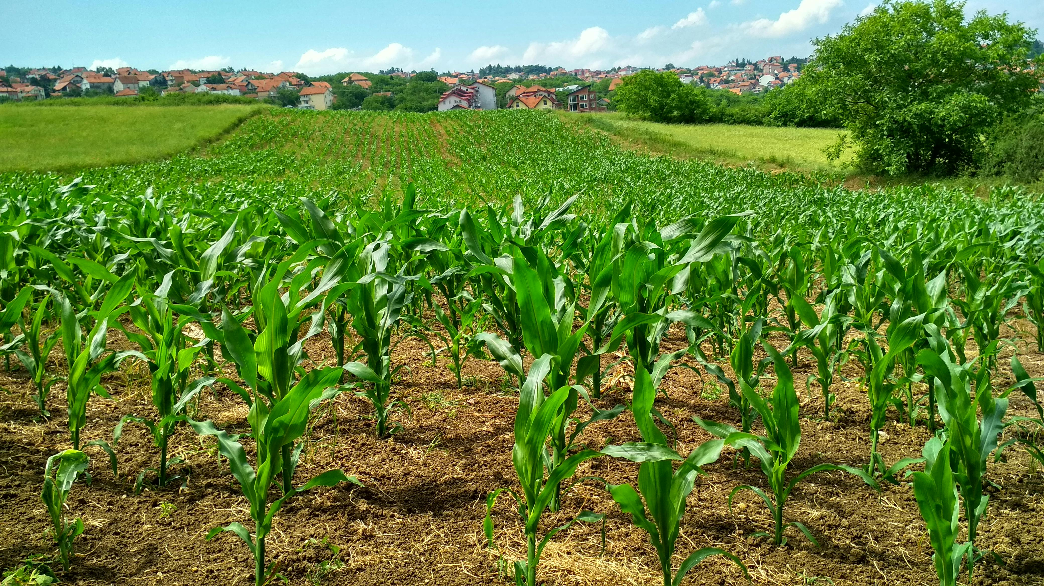


Crop Production Analysis in India
By Himanshu Gautam
Linkedin
Github

Slide 2
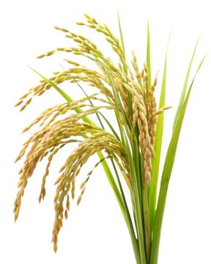
As a vital part of the overall supply chain, the Agriculture business domain is expected to evolve highly in the upcoming years via the developments, which are taking place on the side of the Future Internet. This paper presents a novel Business-to-Business collaboration platform from the agri-food sector perspective, which aims to effectively and flexibly facilitate the collaboration of numerous stakeholders belonging to associated business domains.

Slide 3
Raw Data:
Click here to access the database
The Agriculture business domain, as a vital part of the overall supply chain, is expected to evolve highly in the upcoming years via the developments taking place on the side of the future Internet.
This dataset provides a huge amount of information on crop production in India ranging from several years.
Based on the Information the ultimate goal would be to predict crop production and find important insights highlighting key indicators and metrics that influence crop production.

Slide 4
Data Manipulation and ETL:
Importing data from CSV file to Power BI
Cleaning data to remove duplicates, missing values, and outliers for accurate analysis.
ETL in Power Query Editor
Tasks:
Data Cleaning
Analysis
Visualization
Technologies used:
Power BI
Power Query Editor

Slide 5
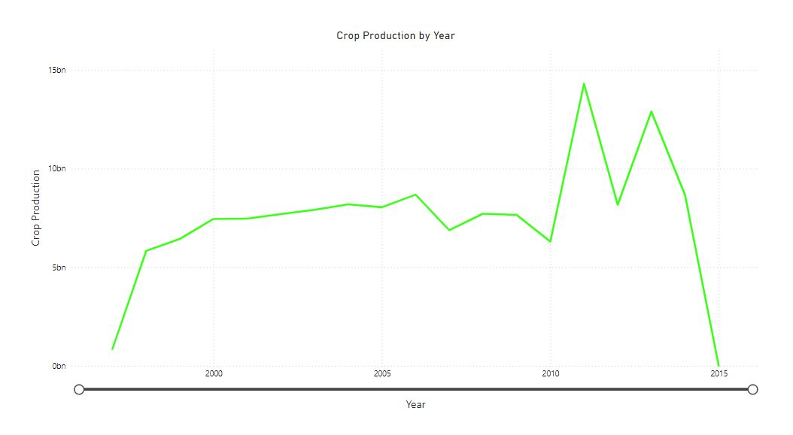
Crop Production By Year

Slide 6
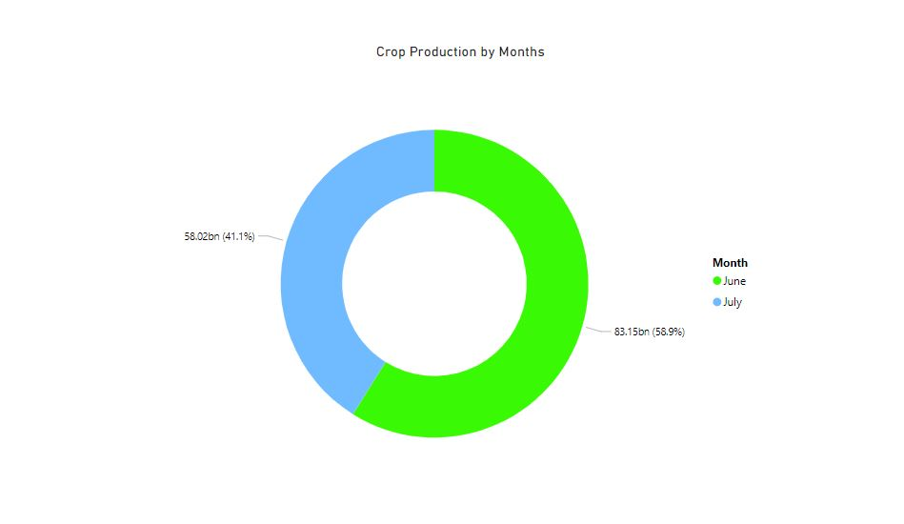
Crop Production By Month

Slide 7
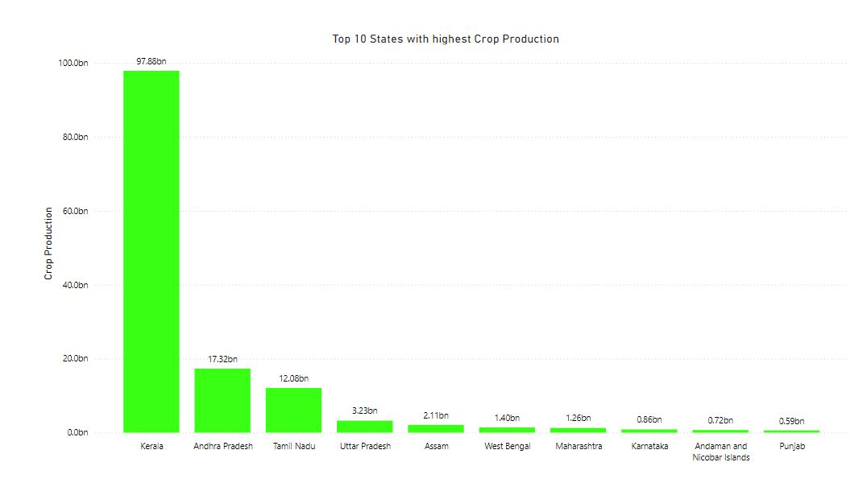
Top 10 States with Highest Crop Production

Slide 8
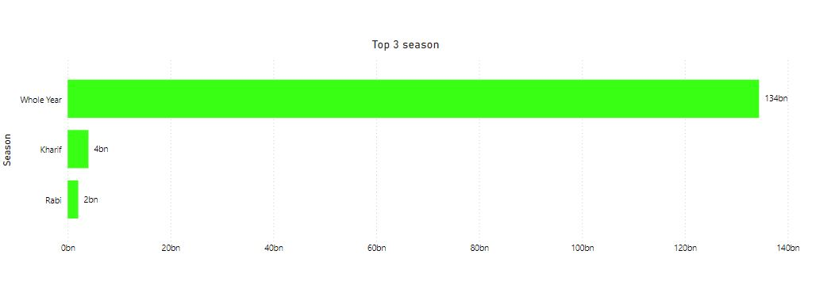
Top 3 Seasons with Highest Crop Production

Slide 9
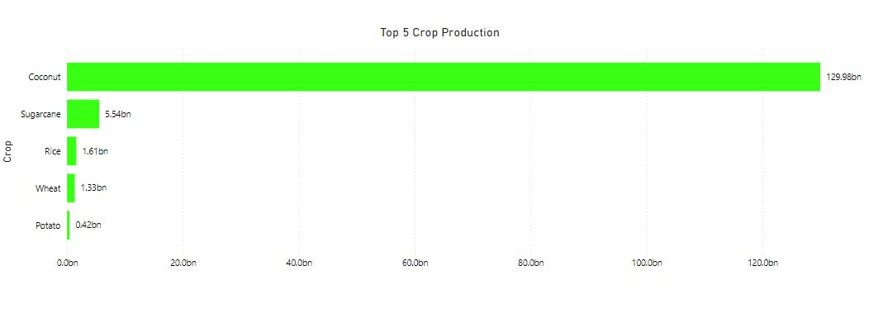
Top 5 Crop Production

Slide 10
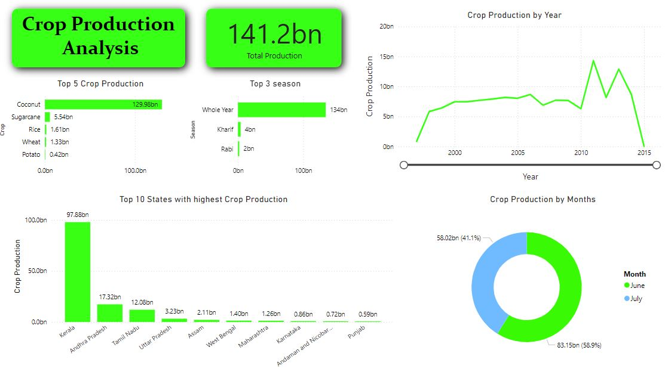

Slide 11
Sample Insights:
Identified trends and patterns in crop production over the years
Total crop production is 141.2 Billion
Crop Production increases in the year 2010 and goes till the year 2011, making 2011 the highest year of crop production
Most of the crop production is produced in June i.e., around 58.9%
Kerala is the top state in crop production and produced around 97.88 Billion
Most of the crops are produced the whole year which is 134 Billion and the second highest season of crop production is Kharif which is 4 Billion
Coconut is produced highest which is 129.98 Billion

